Slide 1
Green Awareness Survey
Conducted during 2017

Slide 2
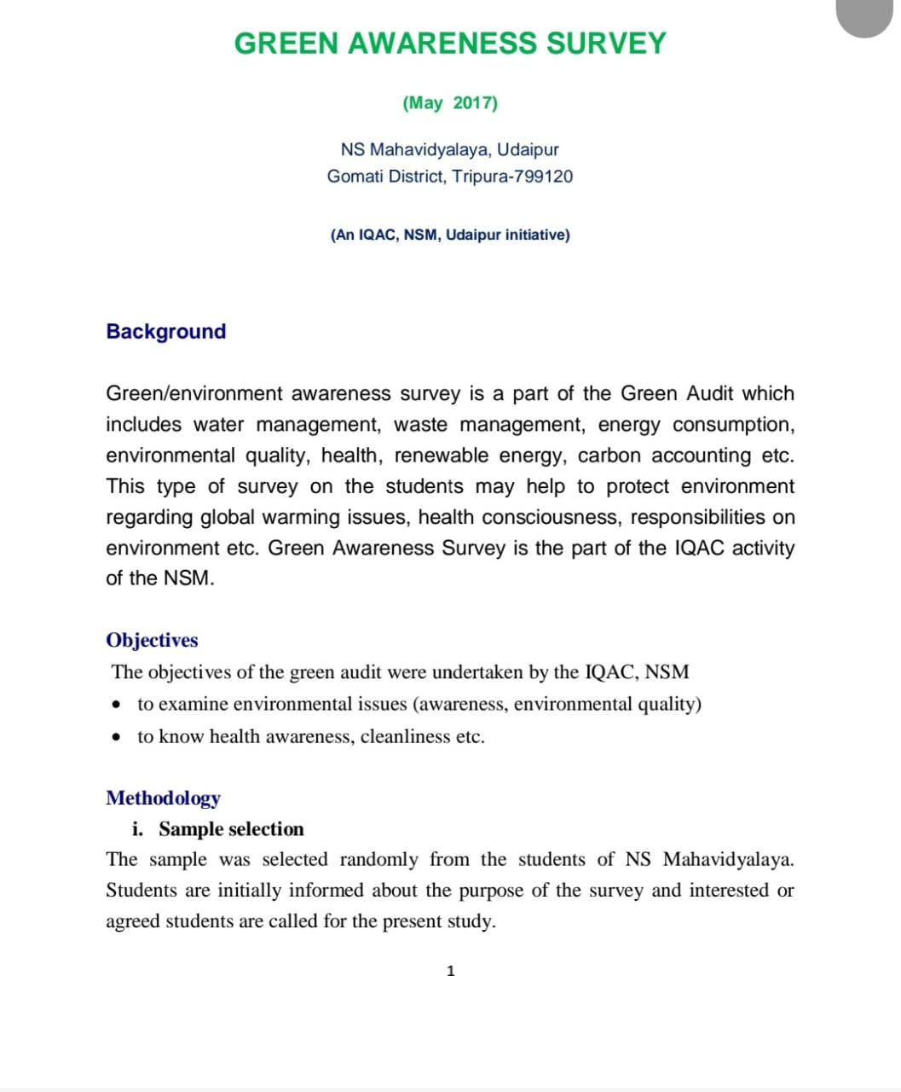
World day to Combat Desertification and Drought Observation-17th June

Slide 3
Green Audit
was conducted 2020-2021
By External & Internal audit team

Slide 4
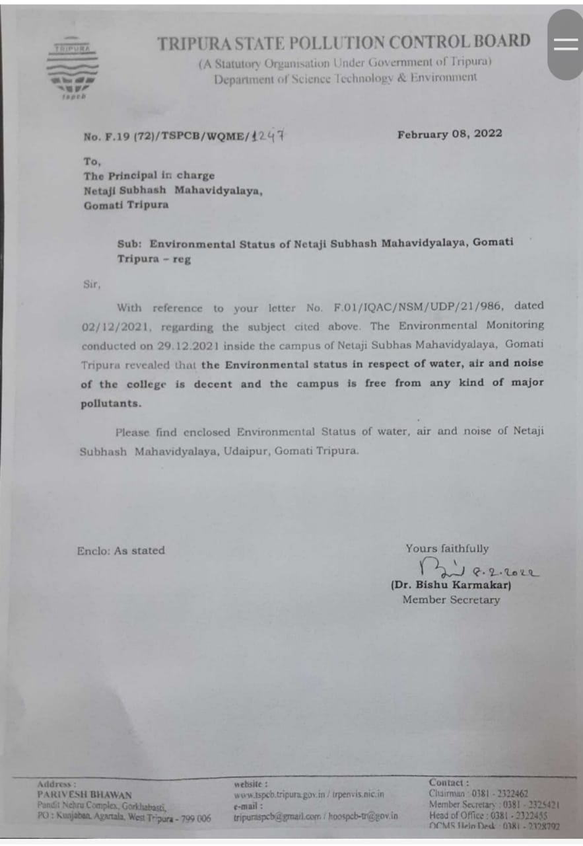
Environmental Audit (water, air & Noise) Report by Tripura State Pollution Control Board

Slide 5
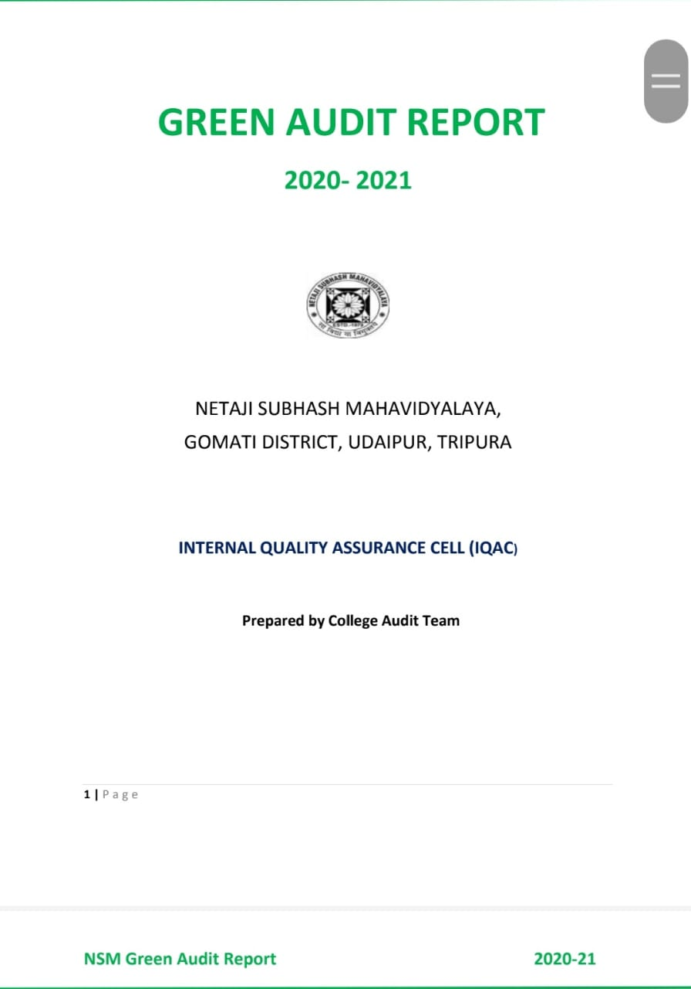
Green Audit Report

